Slide 1
FINAL YEAR PROJECT
ELECTRONICS & COMMUNICATION ENGINEERING
BATCH 2014

Slide 2
AUTOMATIC TRAFFIC LIGHT CONTROLLER USING IMAGE PROCESSING
Sourav Panda
Aman Kedia
Suddhasattwa Das
Vikash Kumar Sinha
Snehashish Paul
project guide-
prof. Amrita Banerjee

Slide 3
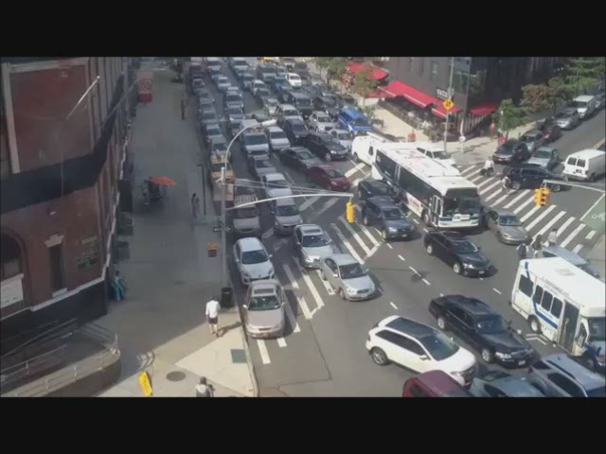
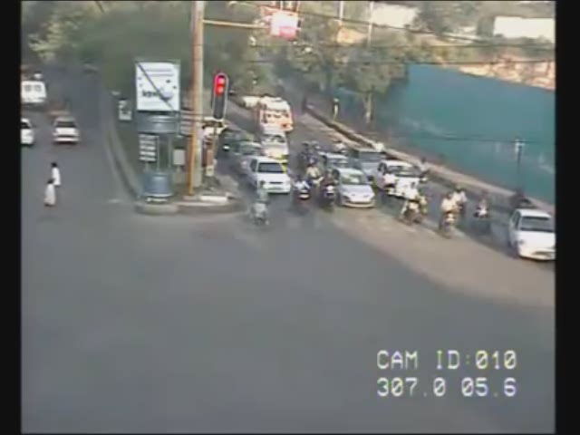
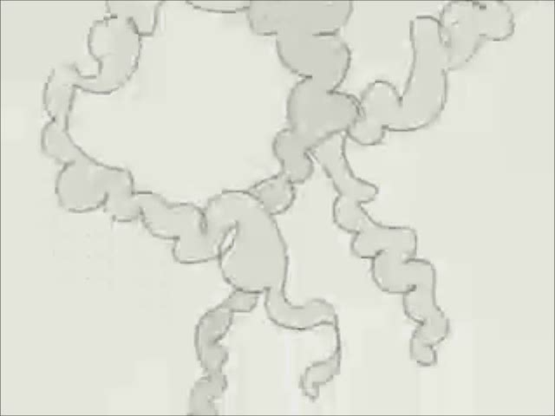
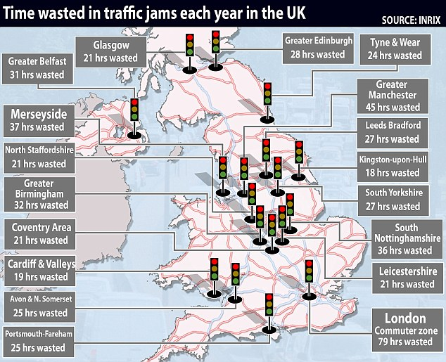
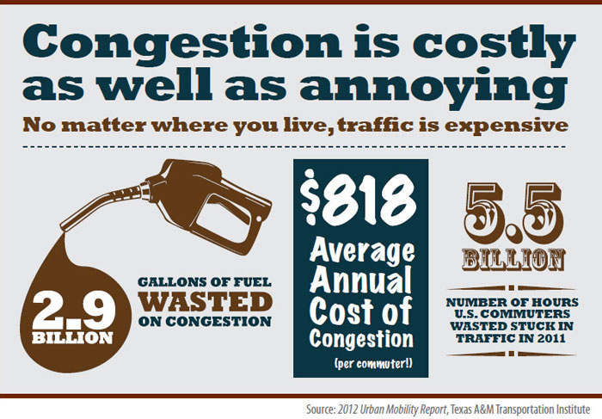
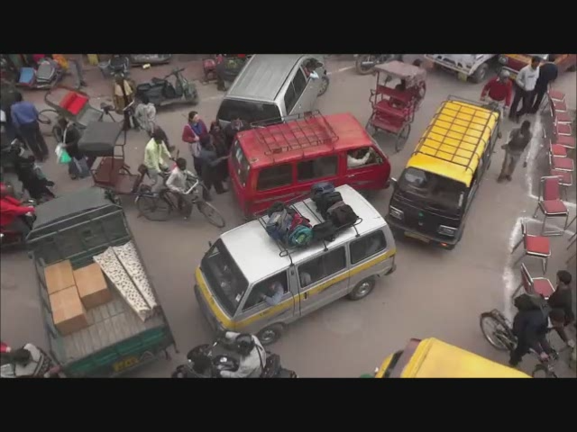
Everyday, the city wastes a lot of time on traffic jams
Moreover, negligence of traffic police even leads to escape of the culprit
A lot of fuel is also wasted
Negligence in following traffic lights leads to accidents
Notes:
Negligence in following lghts leads to accidents

Slide 4


Slide 5
AUTOMATIC TRAFFIC CONTROLLER USING IMAGE PROCESSING

Slide 6
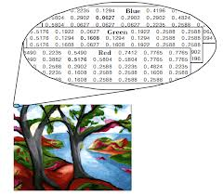

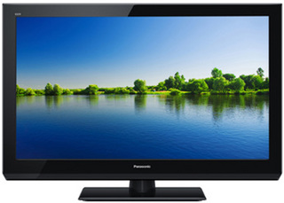



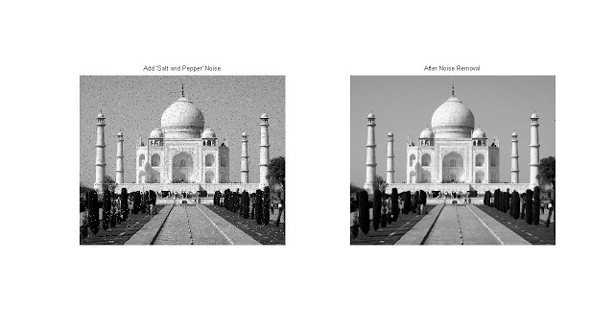
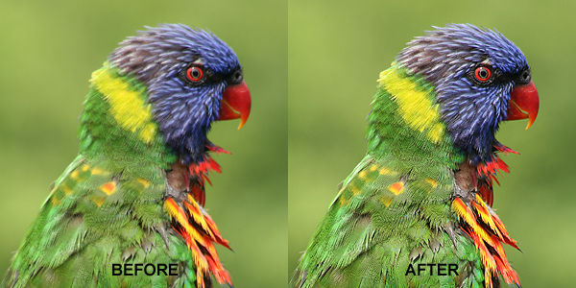
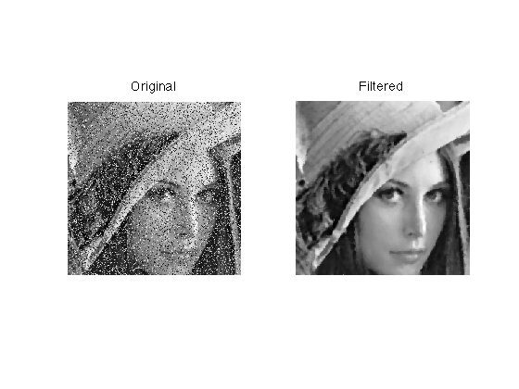

IMAGE PROCESSING
EDGE DETECTION
Image is sent to Computer
Algorithm is applied to change the values appropriately to bring out desired effects
REMOVING NOISE
An image is taken by a DIGITAL CAMERA
Image is a 3 dimension matrix of number describing the intensity values of RGB components
SHARPENING
IMAGE is sent for display
FILTERING

Slide 7

PRESENT SCENARIO
200
200
200
200
CONTROLLER

Slide 8



80
80
80
80
CONTROLLER

Slide 9
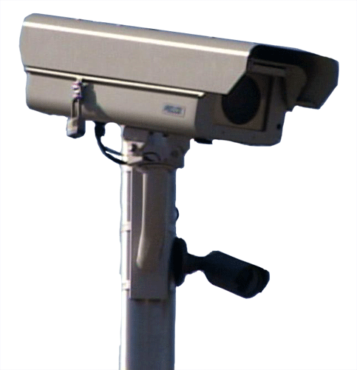
WITH AUTOMATIC CONTROLLER
10
10
10
10
CONTROLLER

Slide 10
90
90
90
90

Slide 11
10
10
10
10

Slide 12
SYSTEM DESIGN
TRAFFIC CAM
IMAGE PROCESSING
Image RGB to GRAYSCALE conversion
GRAYSCALE to BINARY conversion based on a Thresholding value
Selecting the REGION of INTEREST
Edge Detection using SOBEL’S EDGE DETECTION
Filtering using AVERAGE FILTER method
Generating a TIMER value
DB9 CONNECTOR

Slide 13
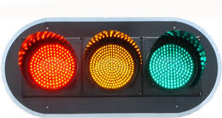
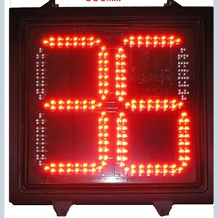
MICROCONTROLLER
LED TRAFFIC LIGHTS
COUNTDOWN TIMER

Slide 14
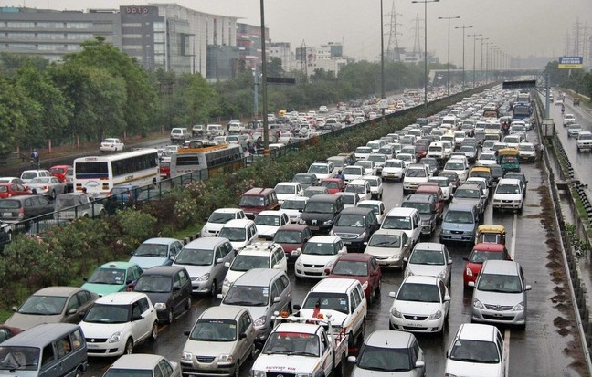
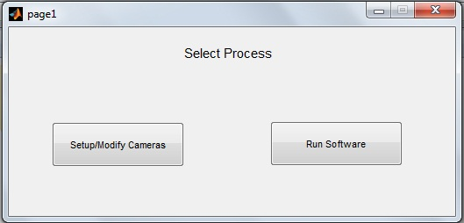
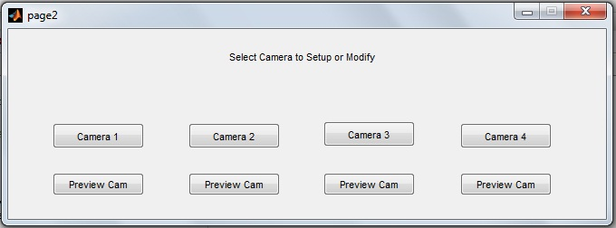
SOFTWARE IMPLEMENTATION
DRAW THE REGION OF INTEREST OVER THE SNAPSHOT
SETUP IS A 1 TIME PROCESS TO INITIALISE CAMERAS
SELECT RUN SOFTWARE THEREAFTER
SETUP CAMERA ALLOWS TO INITIALISE CAMERAS AND SETUP REGION OF INTEREST
SOFTWARE ASKS TO SELECT PROCESS

Slide 15
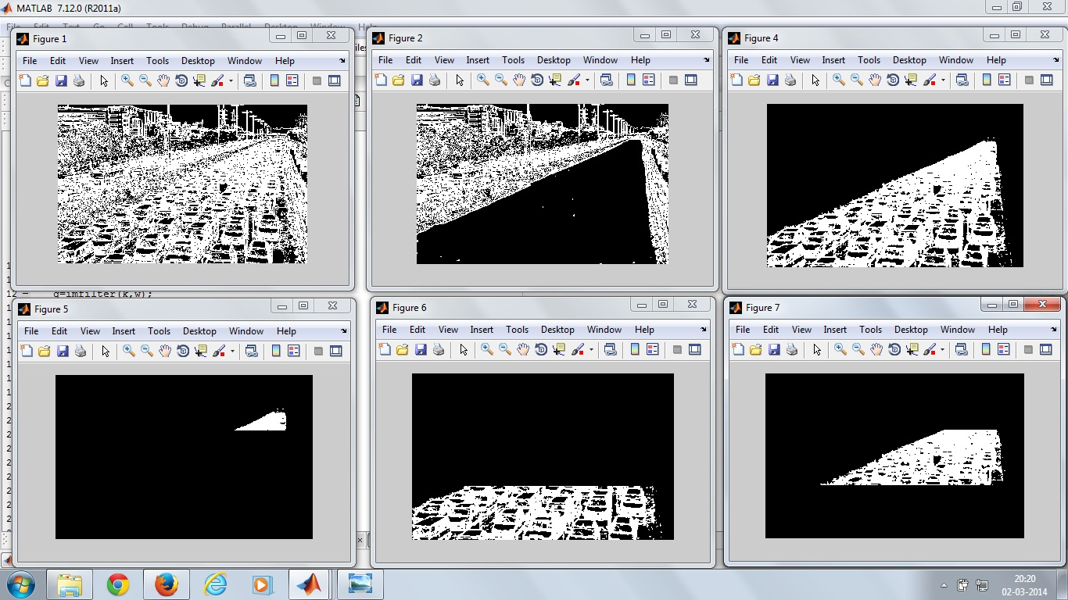
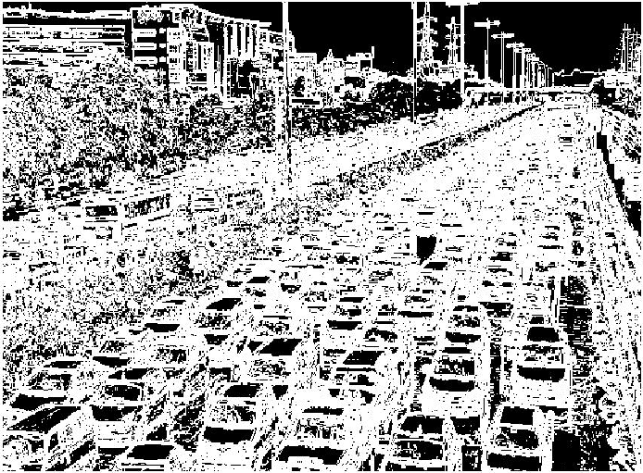
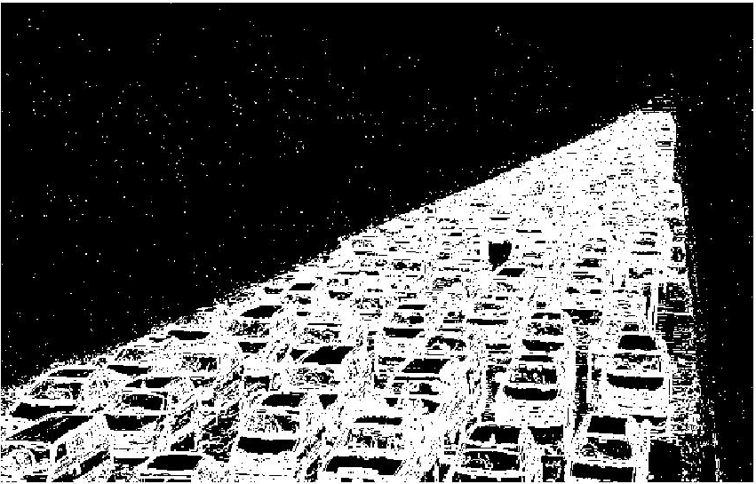

CAMERA AUTOMATICALLY TAKES SNAPSHOTES
THE IMAGE IS SEGMENTED INTO REGIONS TO CALCULATE TRAFFIC DENSITY
APPLIES SELECTED REGION OF INTEREST ON IT
PERFORMS FILTERING
TIMER IS ADJUSTED ACCORDINGLY

Slide 16
FUTURE ENHANCEMENTS
Snapshots can also be taken during the green signal to analyze if there is a sudden increment in traffic
Traffic density can be sent to other traffic crossings to ease the traffic movement during peak hours.
These data can be made available on GSM based query services to give the traffic movement data to private car users to plan their movement accordingly.

Slide 17
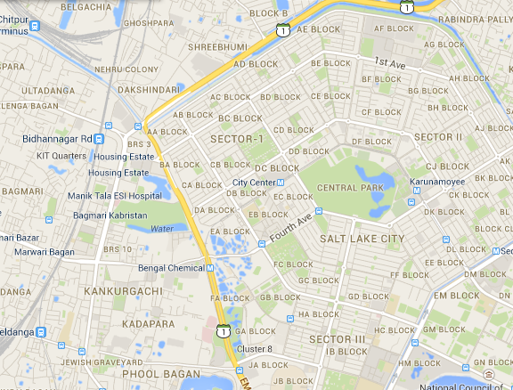
FUTURE ENHANCEMENTS

Slide 18
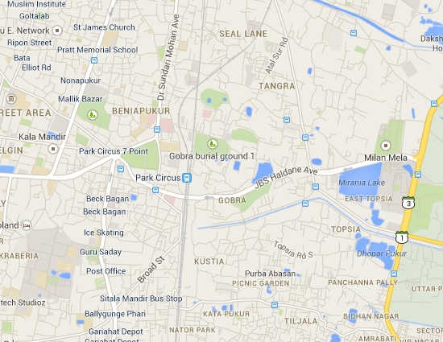

Slide 19
CONCLUSION
Low cost and ease in installation.
More accurate than traditional systems.
Reduction in manpower.
Easy to detect road accidents.

Slide 20
BIBLIOGRAPHY
Books:
    Digital Signal Processing-John.G.Prokias
    Introduction to Digital image processing using MATLAB- Alasdair McAndrew
    Digital Image Processing Using Matlab - Gonzalez Woods & Eddins
Websites:
    www.mathworks.com

